Slide 1
Wise & Mystical

Slide 2
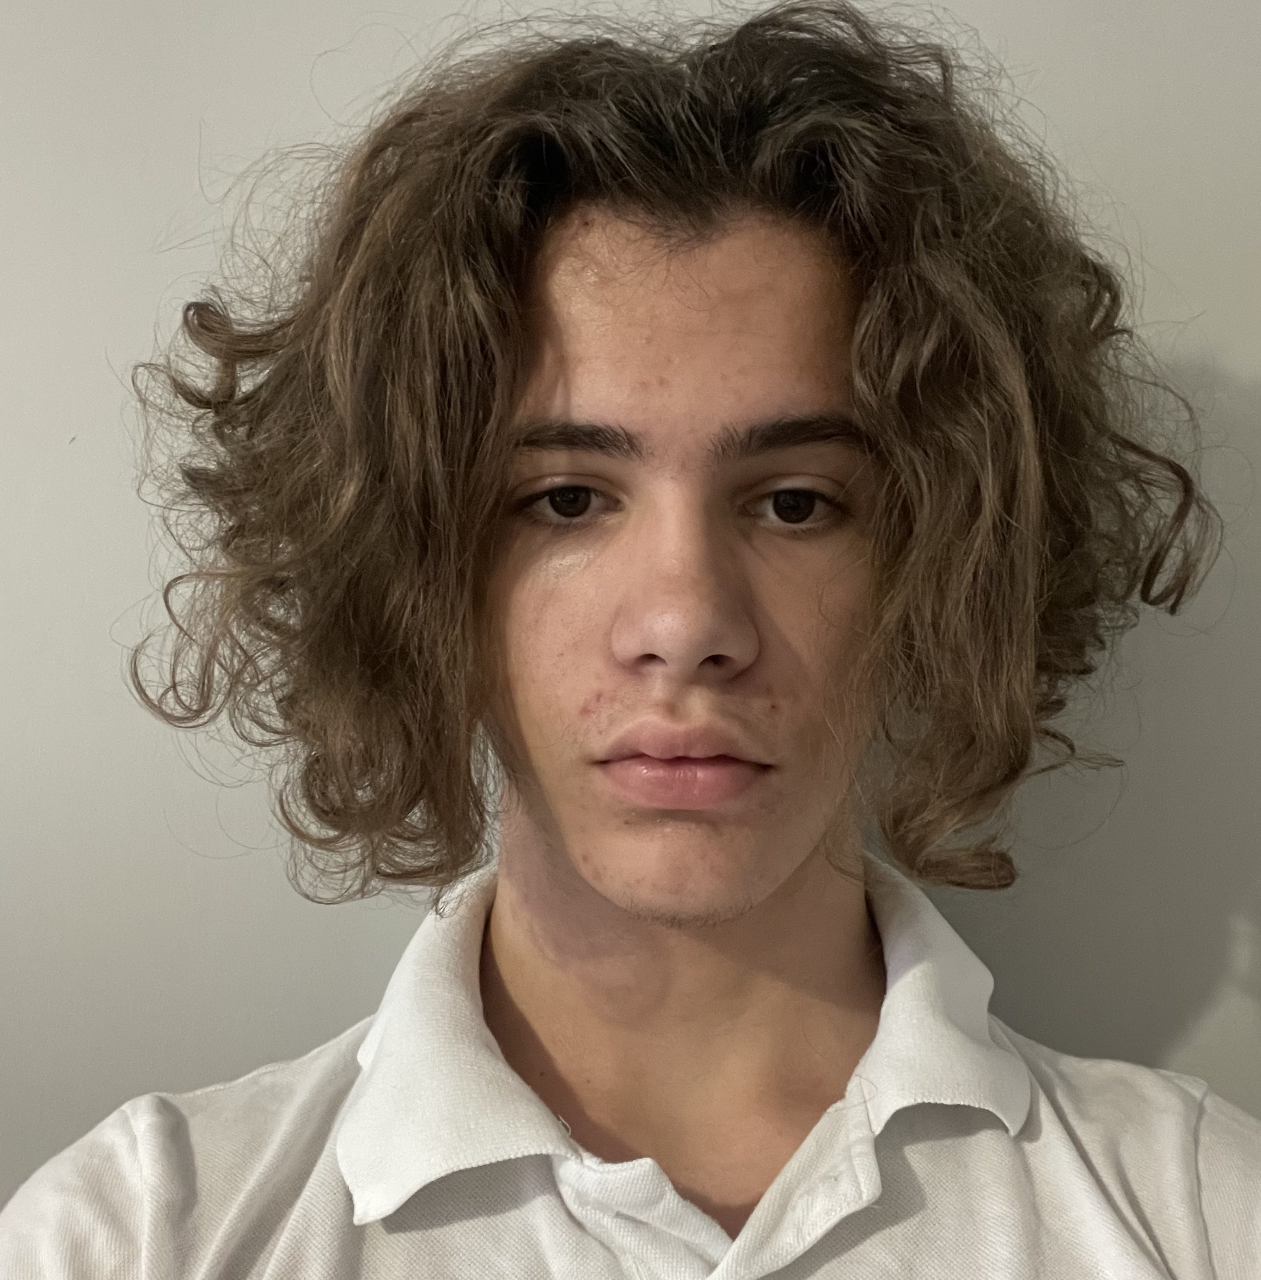
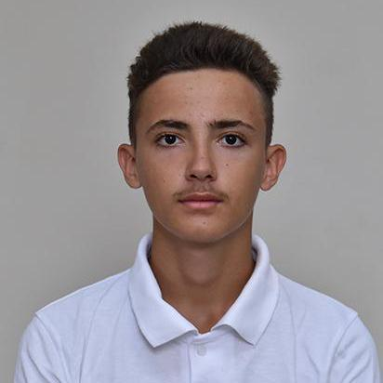
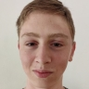
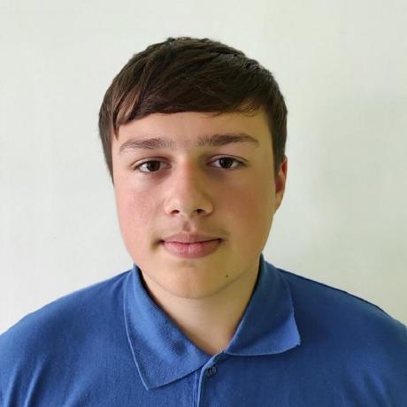
Our Team
Maksim Vasilev
Mihail Petrov
Daniil Furnika
Daniil Chebotarev
Scrum Trainer
Game Developer
Game Developer
QA engineer

Slide 3
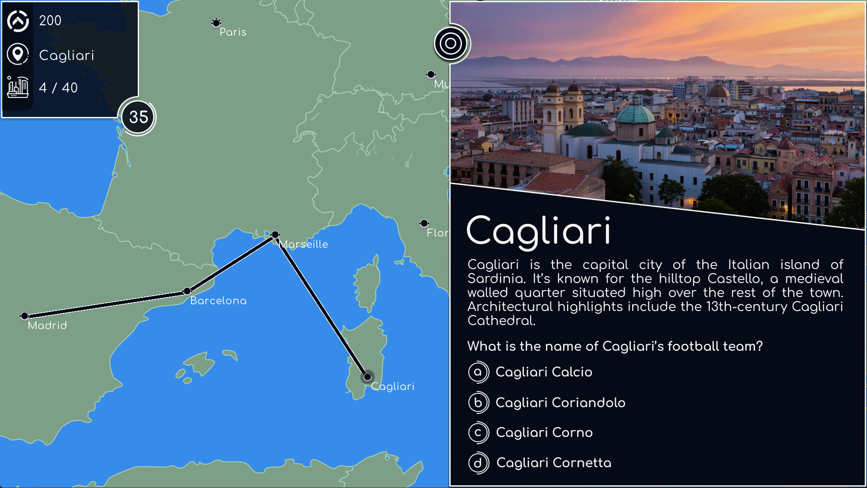
Project Idea
The Idea of our game is to teach people facts about different capitals and big cities around Europe, through quizzes about historical, geo-political or general facts connected to that city.
The goal is to achieve as high of a score as possible. Do keep an eye on your travel points, because once they run out the game ends.

Slide 4
Realization
WEEK 1
WEEK 3
WEEK 2
WEEK 4
Decide on game idea
Get to final stages
WEEK 5
Getting farmiliar and organized
Start working on game
Finishing touches and get ready to present

Slide 5










Technologies Used

Slide 6
Let’s move on to the game

